Slide 1
The programing projects
-
The student : saged Ahmed

Slide 2
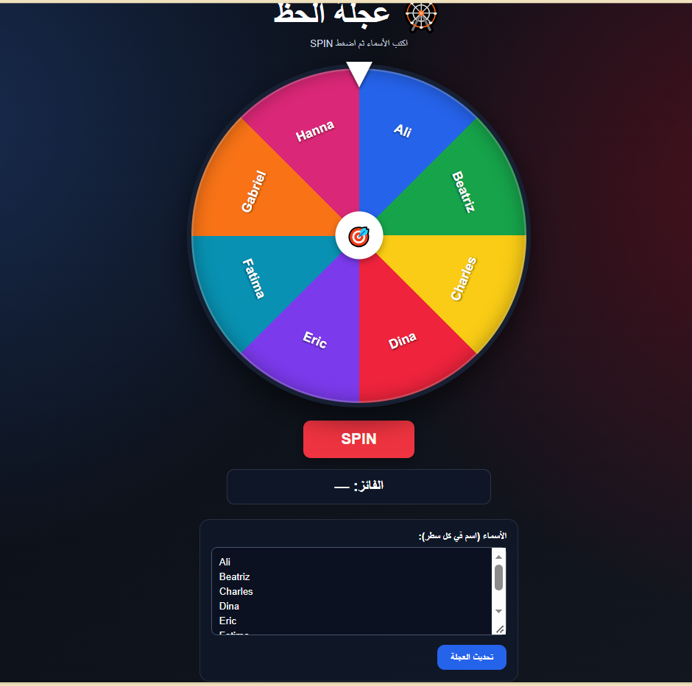
lucky wheel
https://sagedahmedragab111-lgtm.github.io/lucky_wheel/

Slide 3
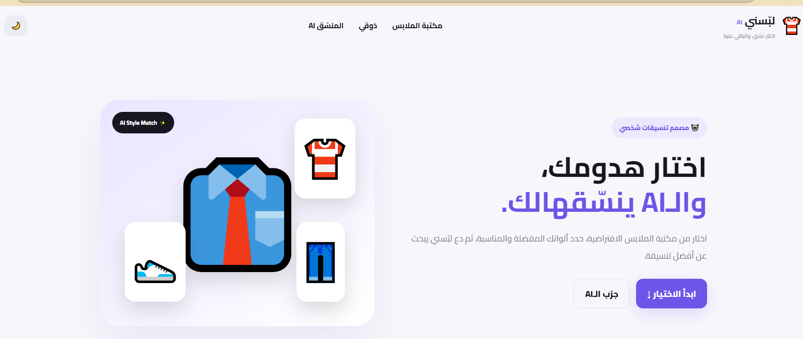
choose my clothes
https://sagedcahmedragab111-lgtm.github.io/choose_my_clothes/
署名占位符

Slide 4
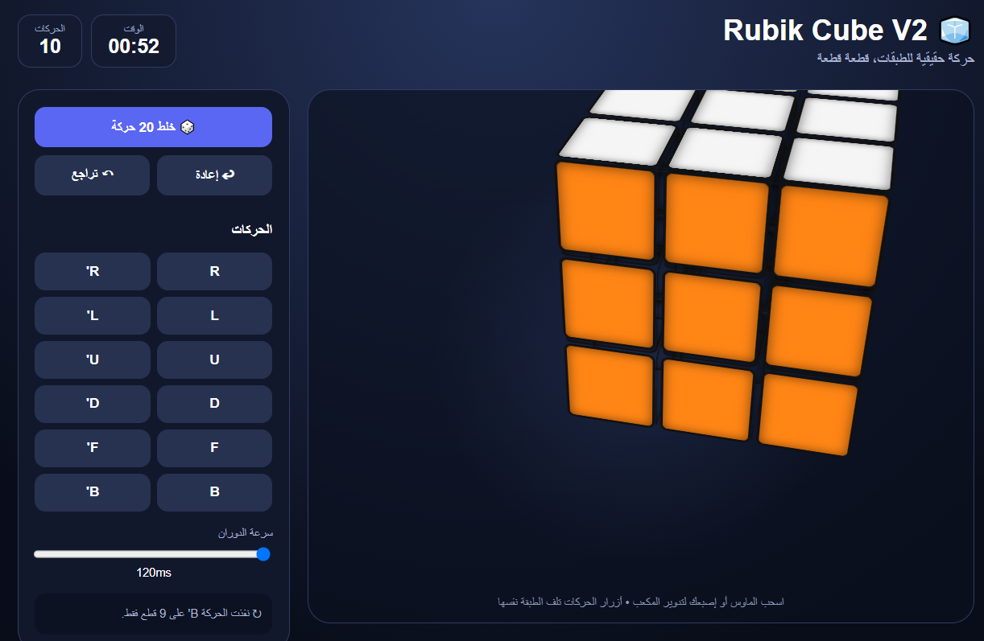
rubik’s cube
https://sagedahmedragab111-lgtm.github.io/ru_cube/

Slide 5
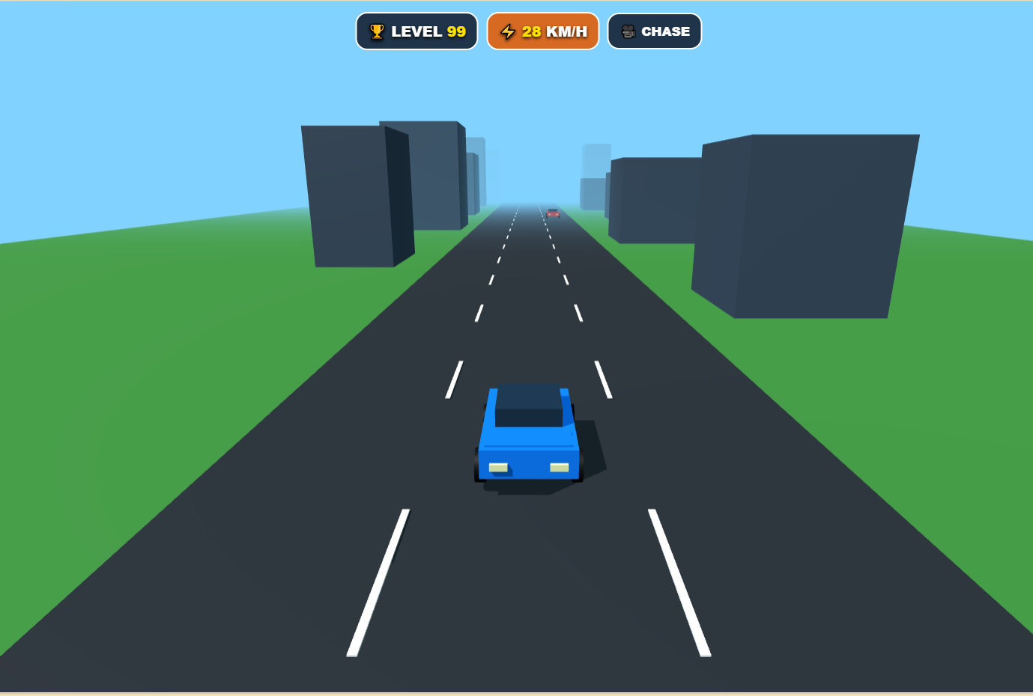
street racer
https://sagedahmedragab111-lgtm.github.io/the_finally_street_racer/

Slide 6
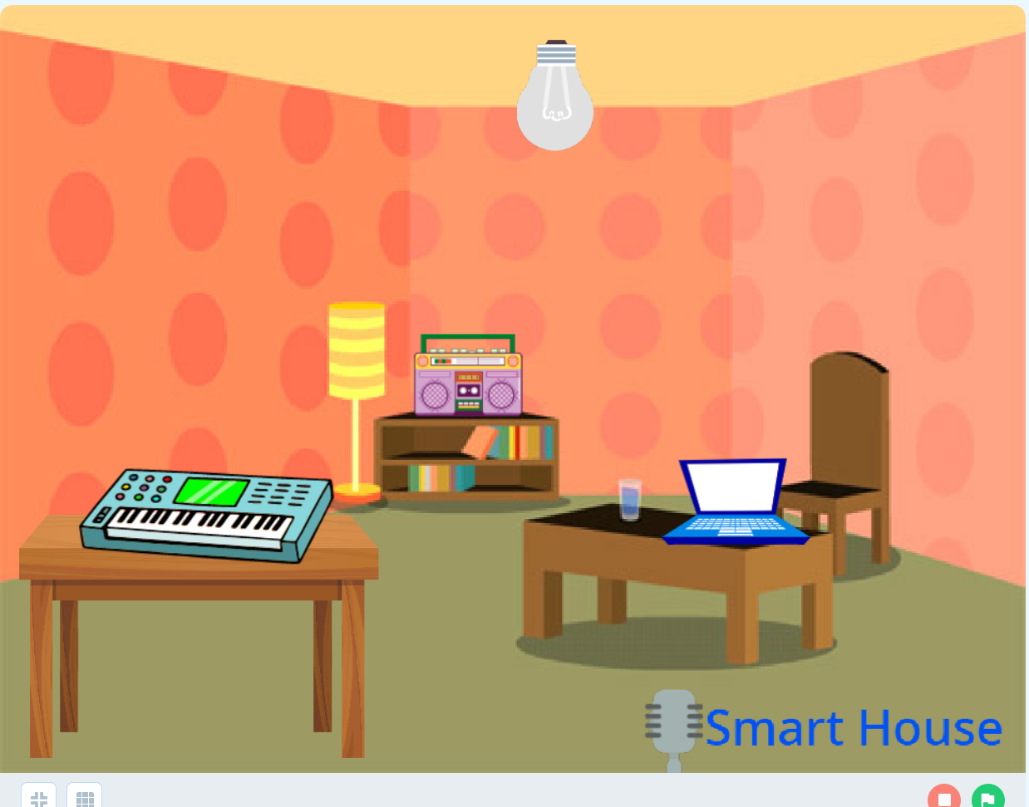
smart home
file:///C:/Users/MMM/OneDrive/Desktop/desktop/smart%20home/Smart%20HomeStudentEnglishVersion(P1)%20(2)%20(1).mblock

Slide 7
thank you

